Slide 1


Green Pace
Security Policy Presentation
Developer: Thomas Cogley
SNHU CS-405-T6651

Slide 2

OVERVIEW: DEFENSE IN DEPTH
Defense in Depth (DiD) multi-layer defense system illustration.

Slide 3
THREATS MATRIX
Likely Threats that occur more frequently | Priority Standards with higher relevance
Low priority Standards with lower relevance | Unlikely Threats that are less likely to occur

Slide 4
10 PRINCIPLES
Validate input
Heed compiler warnings
Architect and design for security policies
Keep it simple
Default deny
Adhere to the principle of least privilege
Sanitize data sent to other systems
Practice defense in depth
Use effective quality assurance techniques
Adopt a secure coding standard
Notes:
Top 10 Secure Coding Practices - CERT Secure Coding - Confluence (cmu.edu)

Slide 5
CODING STANDARDS
Ranking based on severity and priority.
STD-003: Guarantee that storage for strings has sufficient space for character data and the null terminator.
STD-004: Sanitize data passed to complex subsystems.
STD-005: Do not access freed memory.
STD-008: Exclude user input from format strings.
STD-002: Do not read uninitialized memory.
STD-010: Use valid iterator ranges.
STD-009: Do not delete a polymorphic object without a virtual destructor.
STD-007: Handle all exceptions.
STD-001: Declare identifiers before using them. Do not declare a function with an implicit return type.
STD-006: Incorporate diagnostic tests using assertions.
Rule | Severity | Likelihood | Remediation Cost | Priority | Level
STD-001-CLG | LOW | UNLIKELY | LOW | 3 | 3
STD-002-CPP | HIGH | PROBABLE | MEDIUM | 12 | 1
STD-003-CPP | HIGH | LIKELY | MEDIUM | 18 | 1
STD-004-CLG | HIGH | LIKELY | MEDIUM | 18 | 1
STD-005-CPP | HIGH | LIKELY | MEDIUM | 18 | 1
STD-006-CLG | LOW | UNLIKELY | HIGH | 1 | 3
STD-007-CPP | LOW | PROBABLE | MEDIUM | 4 | 3
STD-008-CLG | HIGH | LIKELY | MEDIUM | 18 | 1
STD-009-CPP | LOW | LIKELY | LOW | 9 | 2
STD-010-CPP | HIGH | PROBABLE | HIGH | 6 | 2
Notes:
How this Coding Standard Is Organized - SEI CERT C++ Coding Standard - Confluence (cmu.edu)

Slide 6
ENCRYPTION POLICIES
Encryption in rest: This indicates the data that is stored somewhere without being used by and/or transmitted to anyone (including software, third-parties, human beings, and so on). Encrypting our at-rest data could help us to better deal with a possible Data Breach.
Encryption at flight: The data is being transmitted somewhere to somewhere else. It is important that data is encrypted while in-transit. There are some threats with encryption at flight. This can include eavesdropping and Man-in-the-Middle attacks.
Encryption in use: Whenever the data is not just being stored passively on a hard drive or external storage media, but is being processed by one or more applications-and therefore in process of being generated, viewed, updated, appended, erased, and so on.
Notes:
Data Encryption in-transit and at-rest - Definitions and Best Practices (ryadel.com)

Slide 7
TRIPLE-A POLICIES
Authentication: Authenticating users is the first step in a secure identification system. The system needs to make sure the person accessing a system is who they say they are. The method of authenticating a person can fall into three categories: what they know, who they are, and what they have. Someone’s password can authenticate what they know. A fingerprint or other bio metric tests can authenticate people. Access cards to enter a building can be used to authenticate a person.
Authorization: The right people should have the right access level to areas of a network. Mandatory Access Control (MAC) is the level of security a person is granted relating to the security of the content being accessed. Discretionary Access Control (DAC) is when access to a file or area is given by the owner of that area. Finally, Role-Based Access Control (RBAC) is when access is determined by the role withing an organization.
Accounting: After a person begins logging into a network and working, their usage should be monitored. Knowing what files a person is accessing or attempting to access can inform whether more or less authorization is needed. Suspicious activity can prompt questions as to whether the person accessing the network was authenticated correctly.
Notes:
The AAA Framework for Identity Access Security - Cipher

Slide 8
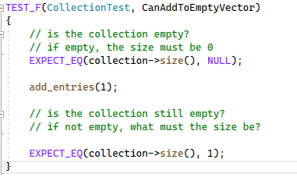
Unit Testing 1: Is a single value added to an empty collection?

Slide 9
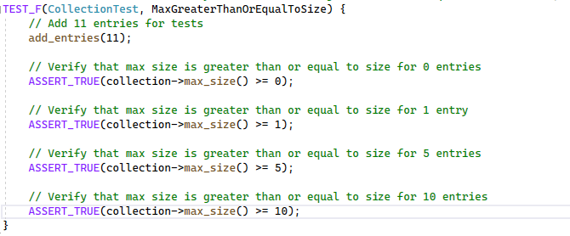
Unit Testing 2: Is the max size greater than 0, 1, 5, and 10?

Slide 10
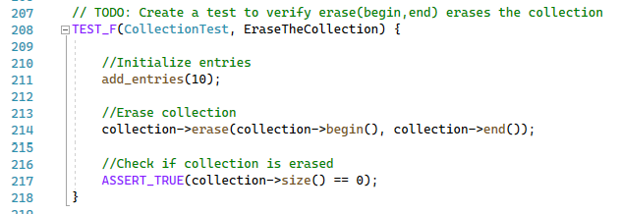
Unit Testing 3: Does using the erase function erase the collection?

Slide 11
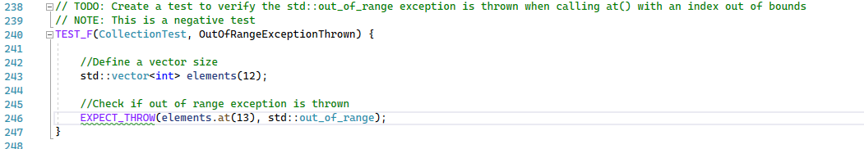
Unit Testing 4: Is out of range exception thrown? (Negative Test)

Slide 12

AUTOMATION SUMMARY

Slide 13
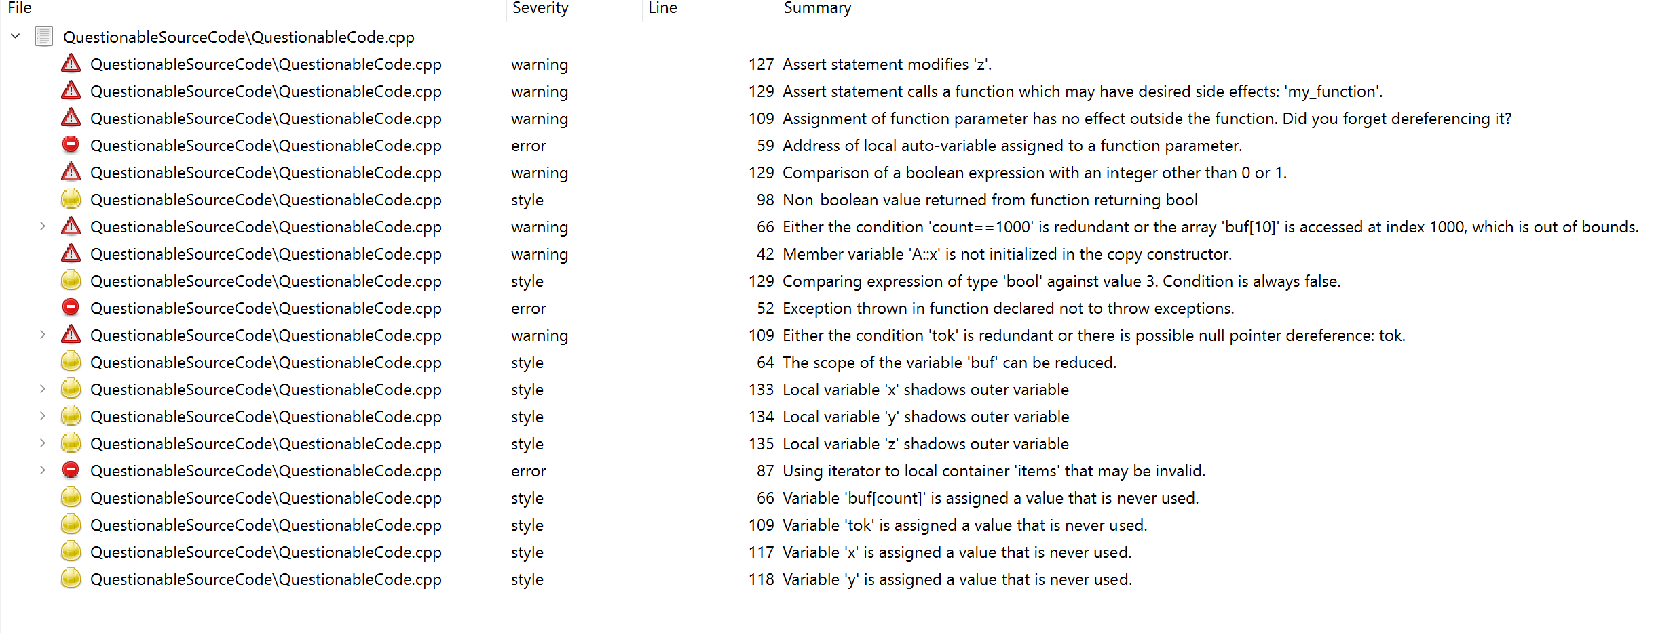
TOOLS
DevSecOps Pipeline: Is used to describe a continuous delivery, security-focused development life cycle (SDLC). Unlike a traditional SDLC where security is not addressed until the end. DevSecOps promotes security engagement as an active part of the Software development life cycle.
Tools: External tools such as cppchecker and IDEs testing are used to discover warnings, errors, and messages when developed code is being executed. Below is the cppchecker in action.
Notes:
DevSecOps Pipeline - A Complete Overview | 2022 (xenonstack.com)

Slide 14
RISKS AND BENEFITS
Now
Risks: Extends the project life cycle between each section of the lifecycle. This is because running many different security codes and test cases will increase the time.
Benefits: Catching security vulnerabilities early can save money. Instead of waiting to the end and doing a thorough search of vulnerabilities it is done in blocks of code.
Wait
Risks: If you wait to check for security vulnerabilities it will be more time consuming and the potential of missing some is high.
Benefits: The development phase of the life cycle will be quicker.

Slide 15
RECOMMENDATIONS
Understanding that faster isn’t always better. Project managers may face pressure from sales, marketing and product teams to hit a release date. However, rushing through code and not securing it properly throughout the SDLC can cause further issues. One such issue may be money, and release date.
Also, not covered in this security document. But setting regular check for secure coding practices for managing gap analysis and threat modeling and building a checklist of security risks is important.
Notes:
It's time to bridge the gap between security and development | Cybersecurity Dive
Bridging the security gap in the software development life cycle (betanews.com)

Slide 16
CONCLUSIONS
With an increase in technical knowledge among the populace. It is important to always code with security in mind. In today’s world everything is digitalized. This includes customer’s Personally Identifiable Information (PII), which if gained can cause the company to lose credibility, as well as the customer’s sensitive data such as credit card numbers and social security numbers.
Consistently coding with security in mind during the SDLC will eventually become second nature. Many corporations may believe that time is wasted throughout the cycle is security tests are done. However, if waited until the end it can be more expensive, and take longer to mitigate the security issues.

Slide 17
REFERENCES
Top 10 secure coding practices. Top 10 Secure Coding Practices - CERT Secure Coding - Confluence. (n.d.). Retrieved August 13, 2022, from https://wiki.sei.cmu.edu/confluence/display/seccode/Top+10+Secure+Coding+Practices
Confluence. (n.d.). How this coding standard is organized. How this Coding Standard Is Organized - SEI CERT C++ Coding Standard - Confluence. Retrieved August 13, 2022, from https://wiki.sei.cmu.edu/confluence/display/cplusplus/How+this+Coding+Standard+Is+Organized
Ryan. (2021, June 9). Encryption in-transit and encryption at-rest - definitions and best practices. Retrieved August 13, 2022, from https://www.ryadel.com/en/data-encryption-in-transit-at-rest-definitions-best-practices-tutorial-guide/
The AAA framework for Identity Access Security. Cipher. (2020, May 28). Retrieved August 13, 2022, from https://cipher.com/blog/the-aaa-framework-for-identity-access-security/
Bhandari, P. (2022, June 23). DevSecOps pipeline - A complete overview: 2022. XenonStack. Retrieved August 13, 2022, from https://www.xenonstack.com/insights/guide-devsecops-pipeline
Eastwood, B. (2021, August 9). It's time to bridge the gap between security and development. Cybersecurity Dive. Retrieved August 13, 2022, from https://www.cybersecuritydive.com/news/security-development-devsecops/604636/

